Slide 1
Advaced Analytics with TIBCO Spotfire
Pablo Maldonado, Ph.D.

Slide 2
About your trainer
Pablo Maldonado, Ph.D.
Data Science/Analytics Trainer & Consultant.
Project experience in
Telco (CRM / marketing).
Ecommerce and digital marketing.
Analysis of sensor data.

Slide 3
About you
Who are you and what do you do? ☺
What is your previous experience with Spotfire?
What do you expect to get from this course?
What is your main challenge with Spotfire?

Slide 4
Course Outline
Day 1 | Day 2 | Day 3
Getting started with Spotfire. Interactive Dashboards | Different types of visualizations. Data manipulation / window functions. | Scripting & Extensions. Scalability / Performance Improvement.

Slide 5
Timeline
Hands-On: You can follow along, all materials will be available after the course.
https://github.com/jpmaldonado/np-spotfire
9:00-12:00 Morning session
12:00-13:00 Lunch break
13:00-16:00 Afternoon session
Short breaks within morning and afternoon sessions.

Slide 6
Getting started
Create trial account for TIBCO Spotfire Cloud
https://www.tibco.com/spotfire-trial
Download & install TIBCO Spotfire Desktop
https://edelivery.tibco.com/storefront/eval/tibco-spotfire-desktop/prod10954.html

Slide 7
Spotfire at a glance

Slide 8
What is Tibco Spotfire?
Data visualization & analytics software for enterprise-grade solutions.
Main competitors: Qlikview, Tableau, PowerBI.
Advantages:
More connectors.
Good integration with C#/IronPython/R ➔ More flexibility.
Quick prototyping.

Slide 9
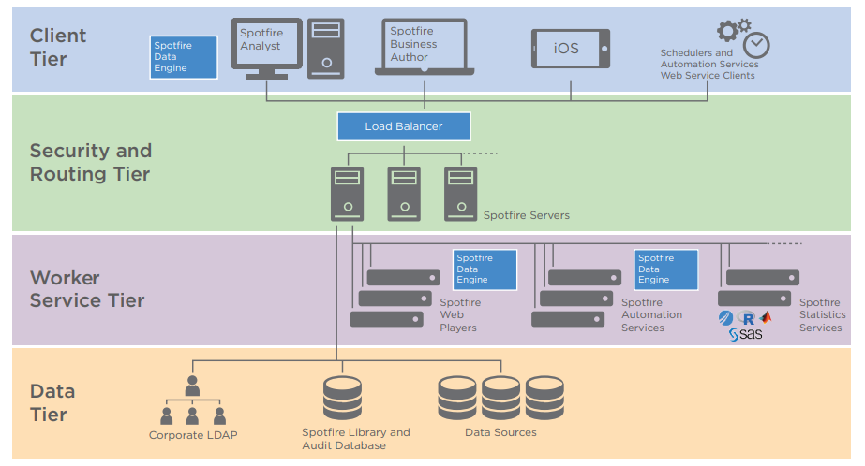
Spotfire Architecture

Slide 10
Spotfire Client Applications
Desktop
Spotfire Analyst: on-premises Spotfire server
Spotfire Cloud Analyst: connects to cloud-based instance.
macOS: wrapper around Spotfire web clients
Web
Spotfire Consumer: read-only web client.
Spotfire Business Author: Some authoring capabilities, like loading data and editing visualizations.
Mobile
Consumer-type client for iOS and Android.

Slide 11
Hands-on!

